Slide 1
Visualization Overview
An overview for getting started with visualizing data
Oliver Eichstedt

Slide 2

Introduction
Data visualization is the discipline of trying to understand data by placing it in a visual context so that patterns, trends and correlations that might not otherwise be detected can be exposed

Slide 3
Introduction
Visualizing data is an important part of conveying a message
Visualization allows to condense large amount of data and display it via a picture (vs. aggregate numbers)
Visualizations should keep the audience in mind
Presenter should convey the message without misleading the audience
Small “tweaks” can make BIG differences!

Slide 4
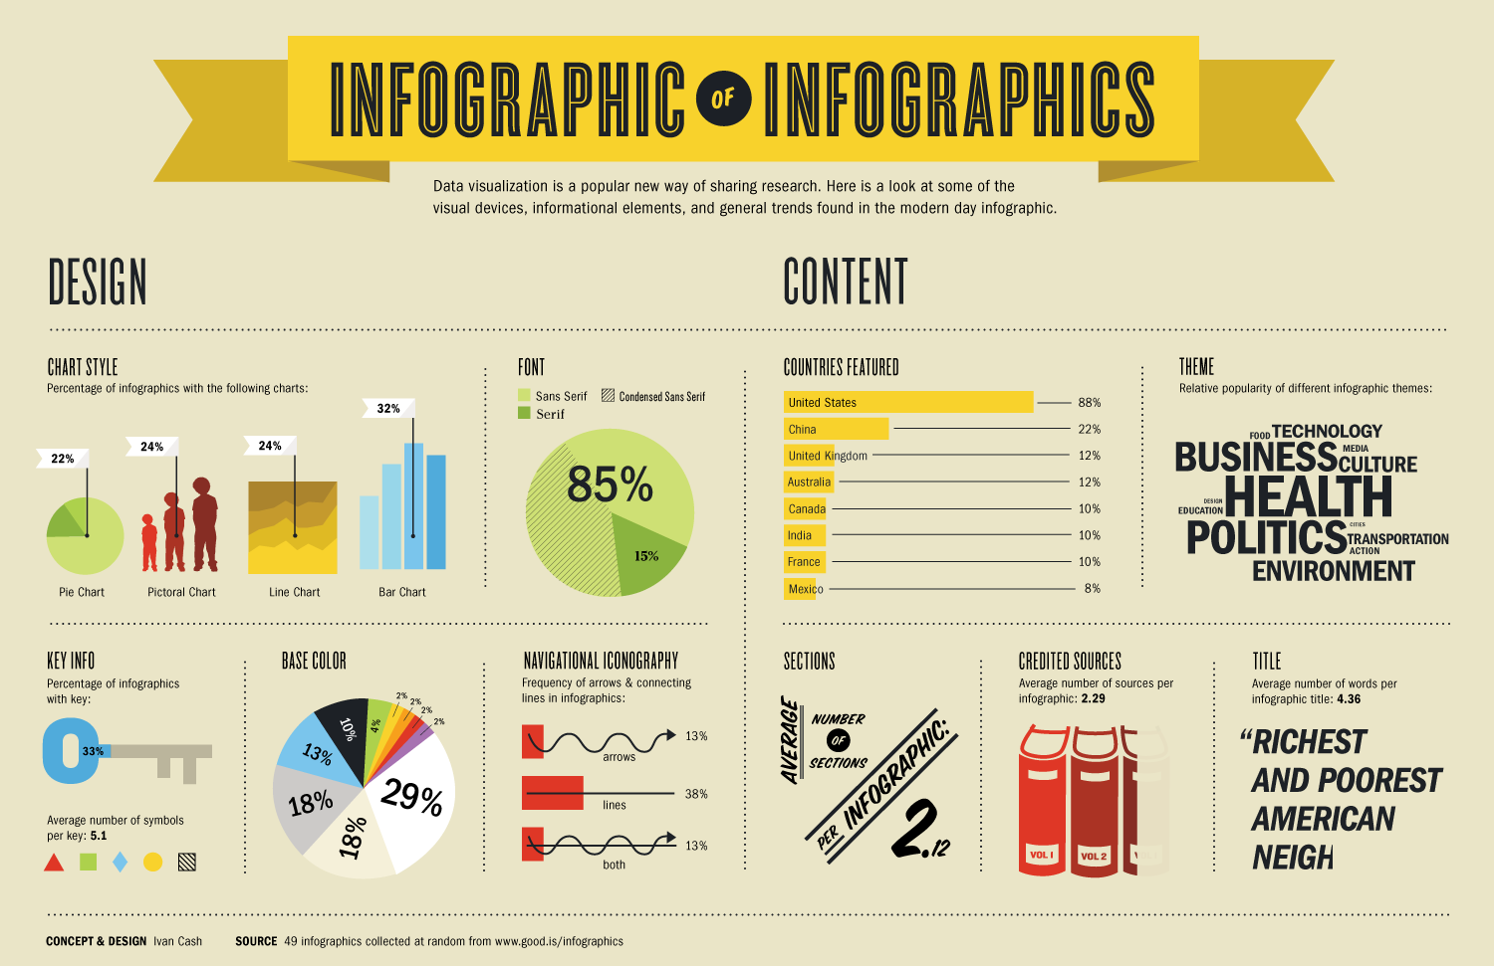
Develop a Story

Slide 5
Considerations
Type of data
Audience
Delivery format

Slide 6
Consideration: Type of data
Data
Continuous vs. discrete
Over time vs. “snapshot”
Single vs. multiple groups

Slide 7
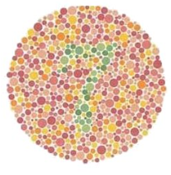
Consideration: Audience
Experts vs. novices
How much time do you have with the audience?
Gender: 10% of men are color blind while only 1% of women are
What do you see in the image to the left?
Source: https://colormax.org/color-blind-test/

Slide 8
Consideration: Delivery format
Projection | Online | Print
Use easy to see visualizations Use a suitable size font Can the slides be viewed from an angle? | Consider the file size because it affects download time Use a suitable resolution (72 pixels per inch) Different monitors will display colors slightly differently | Will you print the material or rely on the reader to print it? Will the reader use a color or black & white printer? Consider the size of the visualization so it fits on a printed page Use a suitable resolution (300 pixels per inch)

Slide 9
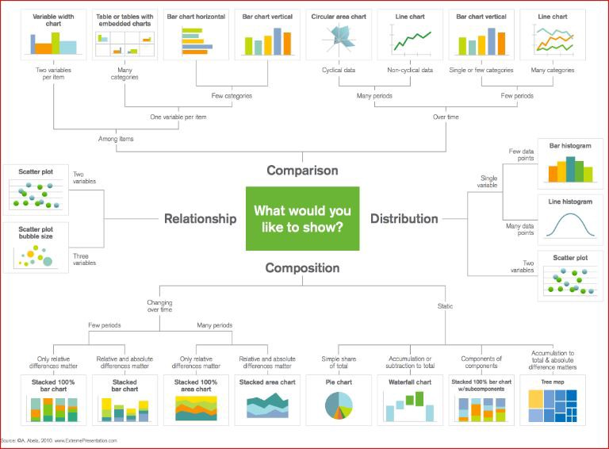
Charts: Types of Charts

Slide 10
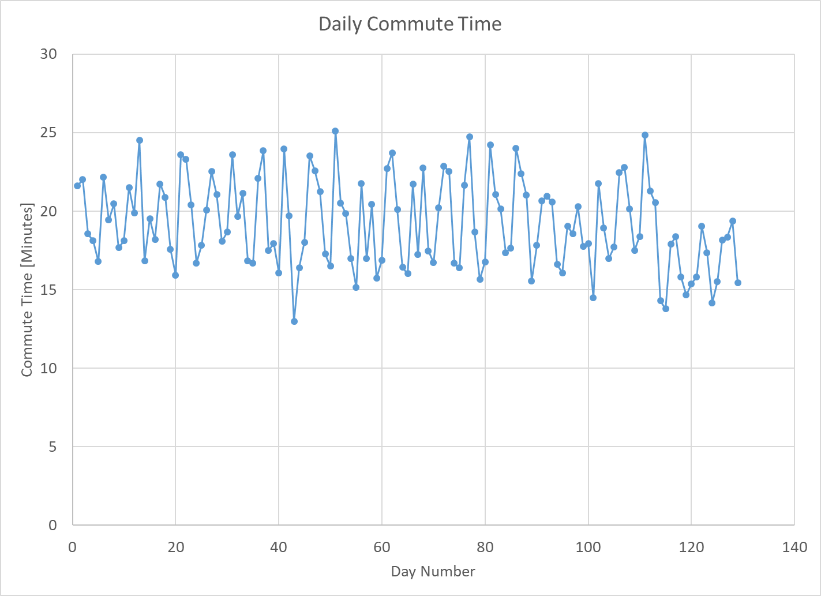
Charts: Parts of a chart
Chart title
y-axis
Chart area
Data points
Axis labels
x-axis
Axis titles

Slide 11
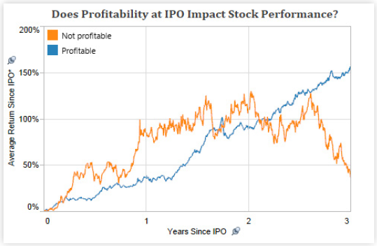
Line Charts Plots y vs. x values as points but only includes x values that are present in the data. Points are connected by lines.
Good for detecting trends or patterns over time
Be careful when x values are missing

Slide 12
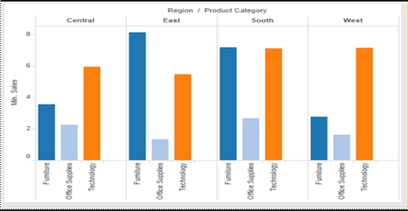
Bar Charts Represents data with vertical or horizontal bars. The size of the bar represents the magnitude of the value.
Good for
Comparing categorical data
Can be sorted
Not good for
Continuous values
Large number of categories

Slide 13
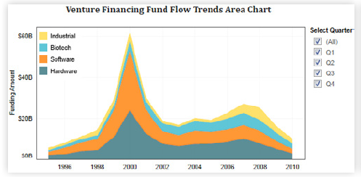
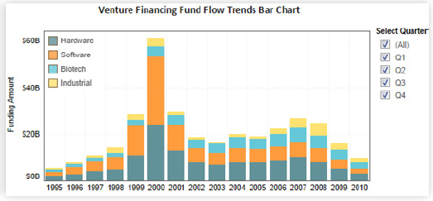
Area Charts/Stacked Bar Charts
Good for looking at components AND total

Slide 14
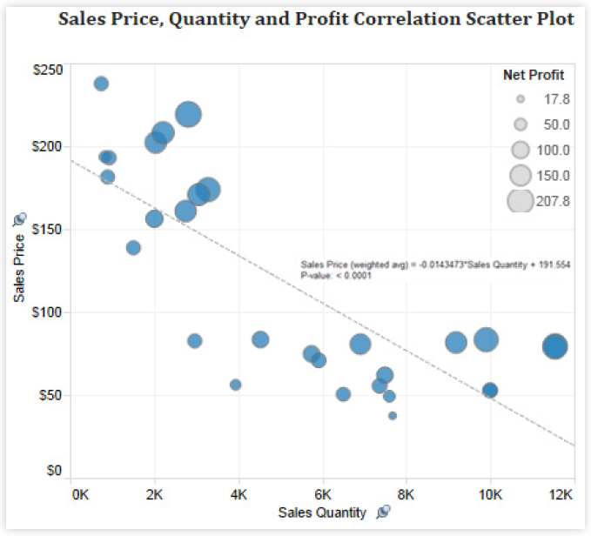
Scatter Plots Plots y vs. x values as points.
Good for
showing correlations
Be careful: correlation <> causation
Seeing trends over time
Not good
Categorical data
Grouped data

Slide 15
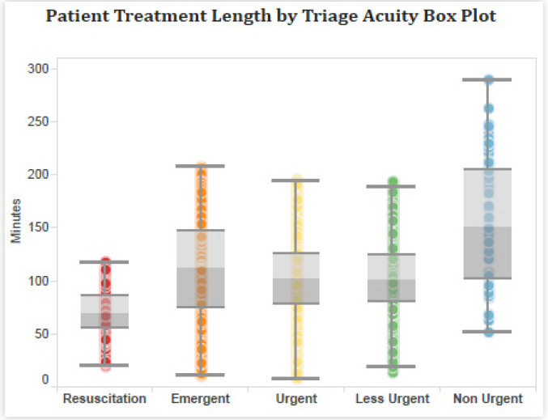
Box Plots A box plot, sometimes called a box and whisker plot, shows the spread of data for multiple categories. It is kind of like showing a few “squished” histograms on one page.
Good for
Showing distribution (spread) of data
Continuous data that can be grouped
Not good for
Continuous values w/o natural grouping
Large number of categories

Slide 16
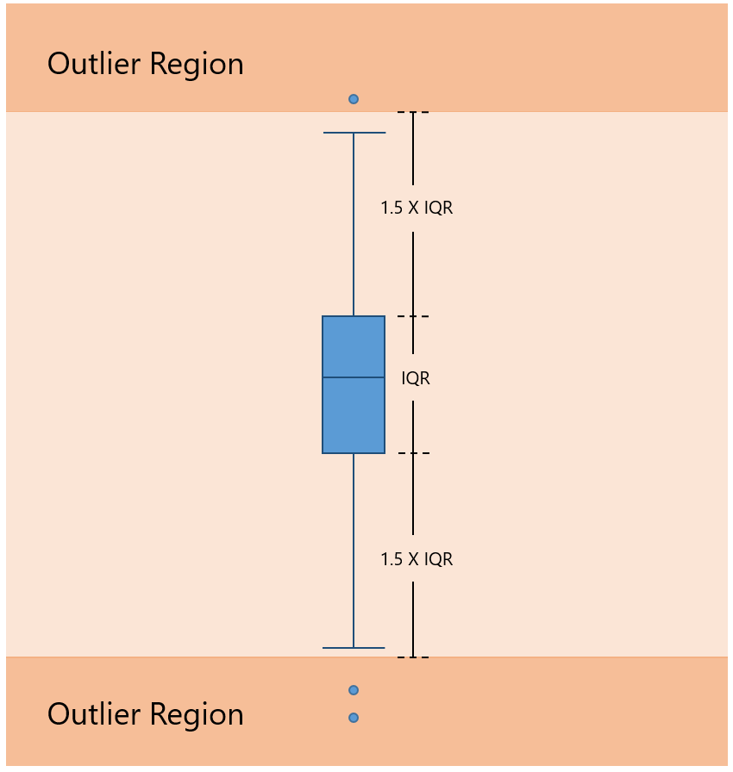
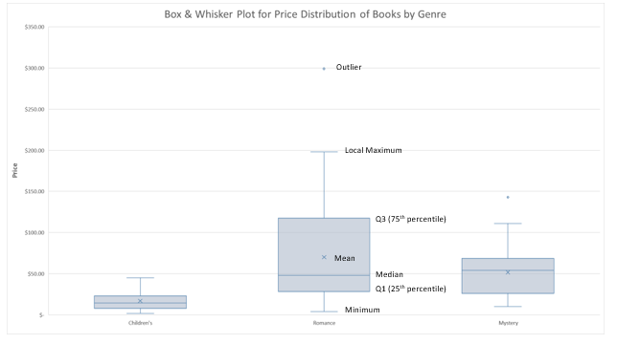
Deciphering a box plot
The objects (boxes, whiskers, markers, etc.) on a box plot can vary slightly depending on the software and the creator of the plot.
Be sure you know how to interpret the box plot you are examining!
The guidelines here are from the Microsoft blog and represent the typical meanings.
Source: https://www.microsoft.com/en-us/microsoft-365/blog/2015/08/18/visualize-statistics-with-histogram-pareto-and-box-and-whisker-charts/

Slide 17
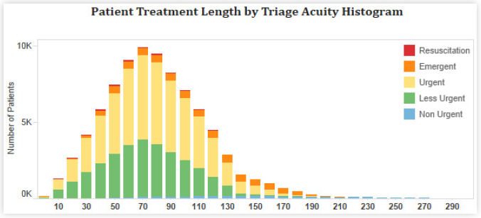
Histogram A histogram creates “bins” (ranges of values) and shows how many data points are in each bin based on the height of the bin’s bar.
Similar to box plot … good for showing the shape of distributions
Not useful for time series data and comparing groups

Slide 18
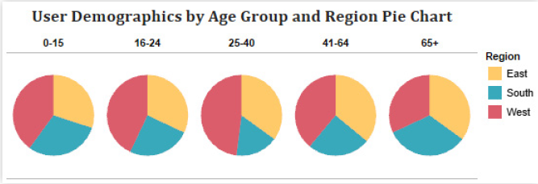
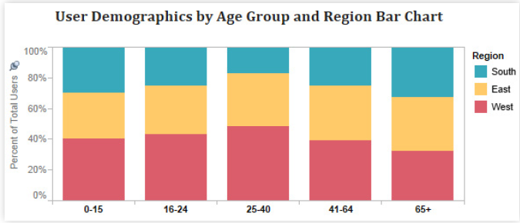
Pie Charts Pie charts are usually used to represent percentage data that adds up to 100%
Avoid using pie charts: Bar charts are often better choice
Human eyes are not good at estimating area
Hard to compare the slices by visually inspecting them

Slide 19
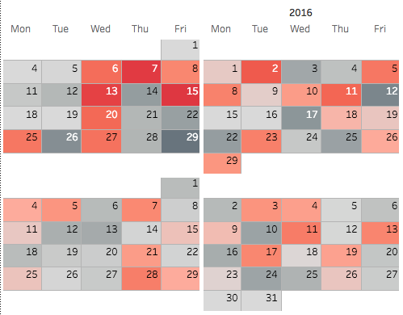
Heat Map (calendar example) A heat map represents values with colors or intensities. Sometimes heat maps can be shaped like a geographical map to represent a country or region.
Good for
Showing three dimensions: x & y axis plus the color intensity
Represent geographical data
Not good for
Showing precise values (numeric values can be displayed to help)
Two dimensional data

Slide 20
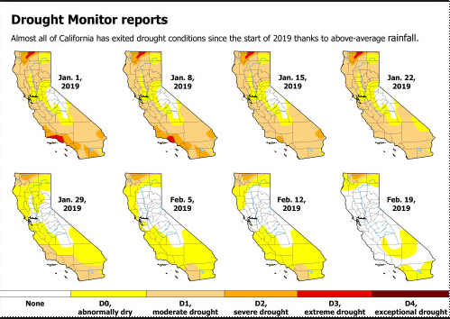
Heat Map (geocoding example) A heat map represents values with colors or intensities. Sometimes heat maps can be shaped like a geographical map to represent a country or region.
Good for
Showing three dimensions: x & y axis plus the color intensity
Represent geographical data
Not good for
Showing precise values (numeric values can be displayed to help)
Two dimensional data

Slide 21
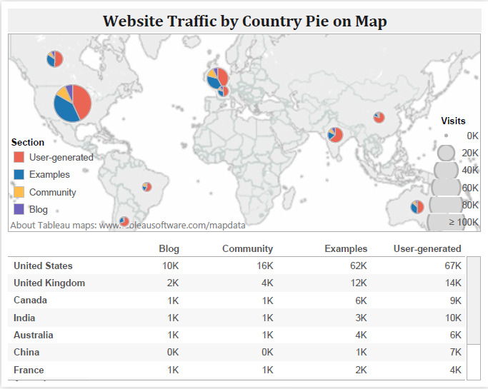
Geocoding Visualization of data on a map
Useful when location is important
Combine maps with the actual data metric

Slide 22
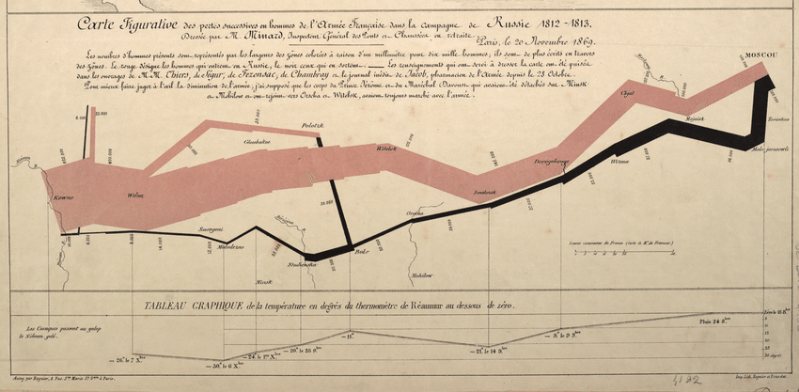
Geocoding
Historic Example: Napoleon’s invasion of Russia

Slide 23
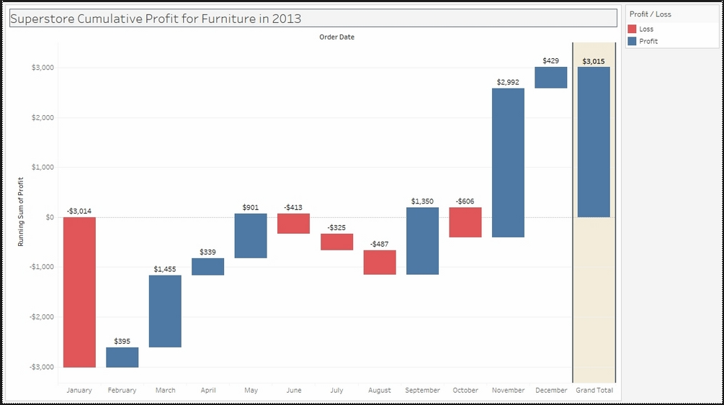
Waterfall Chart Used to visualize addition and subtraction from a starting value to reach and end value

Slide 24

Big Data The Very First Image of a Black Hole
https://www.sciencefriday.com/articles/breaking-first-image-black-hole/

Slide 25
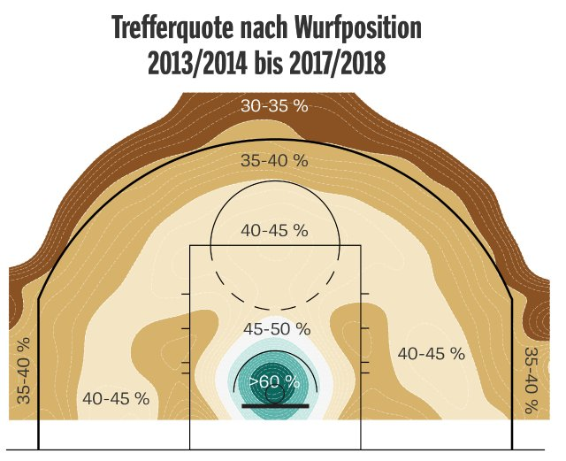
Descriptive Statistics Viz example Kirk Goldsberry - Strawlball

Slide 26
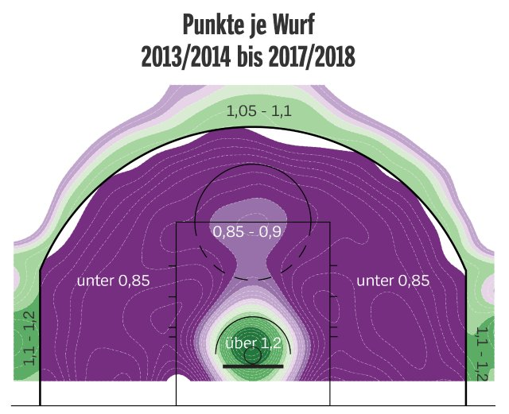
Descriptive Statistics Viz example Kirk Goldsberry - Strawlball

Slide 27
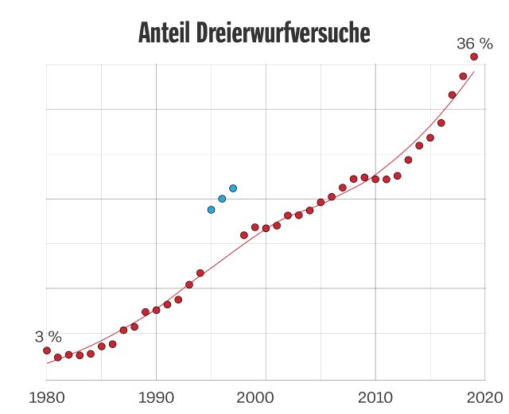
Descriptive Statistics Viz example Kirk Goldsberry - Strawlball

Slide 28
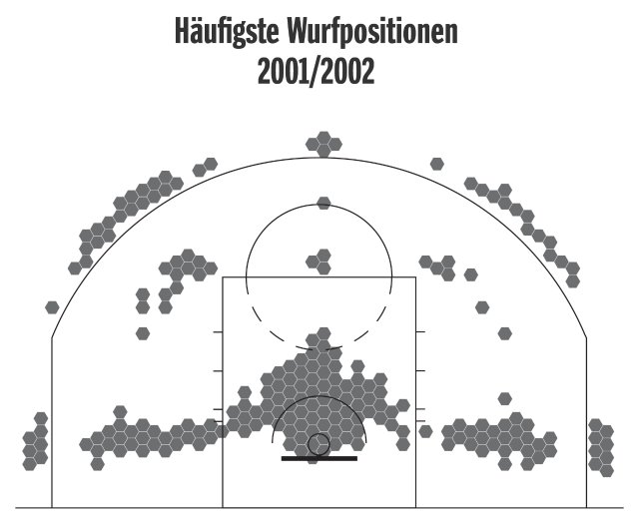
Descriptive Statistics Viz example Kirk Goldsberry - Strawlball

Slide 29
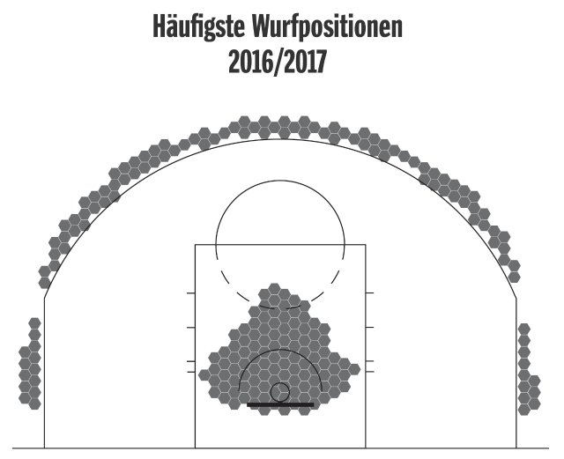
Descriptive Statistics Viz example Kirk Goldsberry - Strawlball

Slide 30
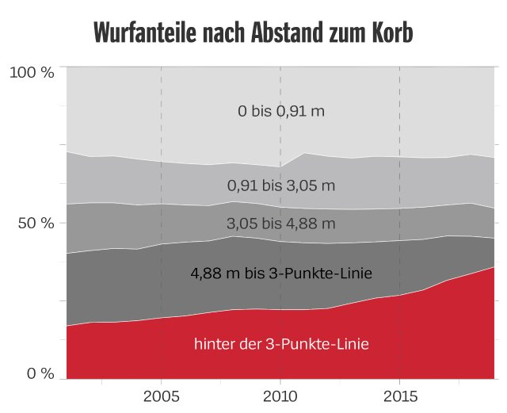
Descriptive Statistics Viz example Kirk Goldsberry - Strawlball

Slide 31
Descriptive Statistics Viz example Kirk Goldsberry - Strawlball

Slide 32
Another Descriptive Statistics Viz example

Slide 33
Best Practices
Do
Use the appropriate chart type
Use consistent chart types
Avoid distortion
Use consistent ranges when comparing charts
Keep it simple (avoid 3D effects)
Maximize info to ink ratio
Don’t
try to answer too many questions with a single graph
use metrics that are hard to understand
clutter the graph with unnecessary items
forget labels
overuse colors
skip values on the x-axis
make font size too small

Slide 34
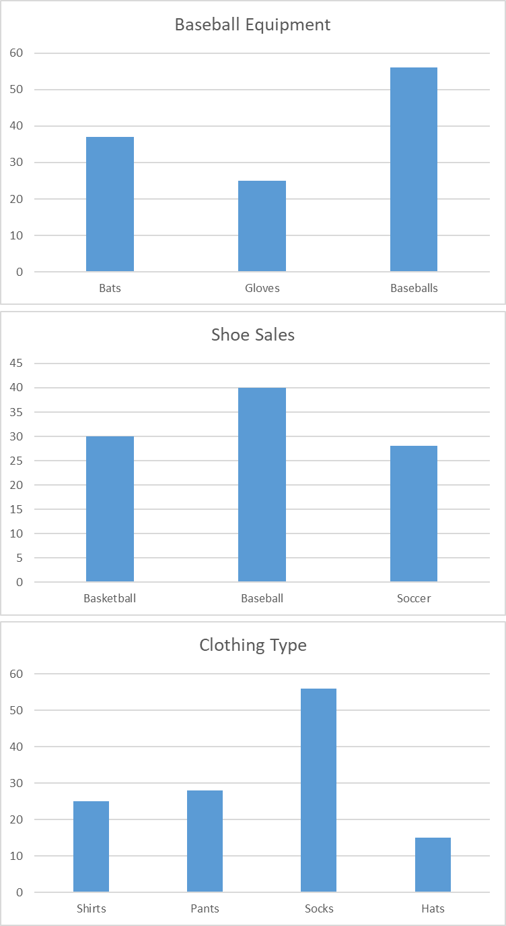
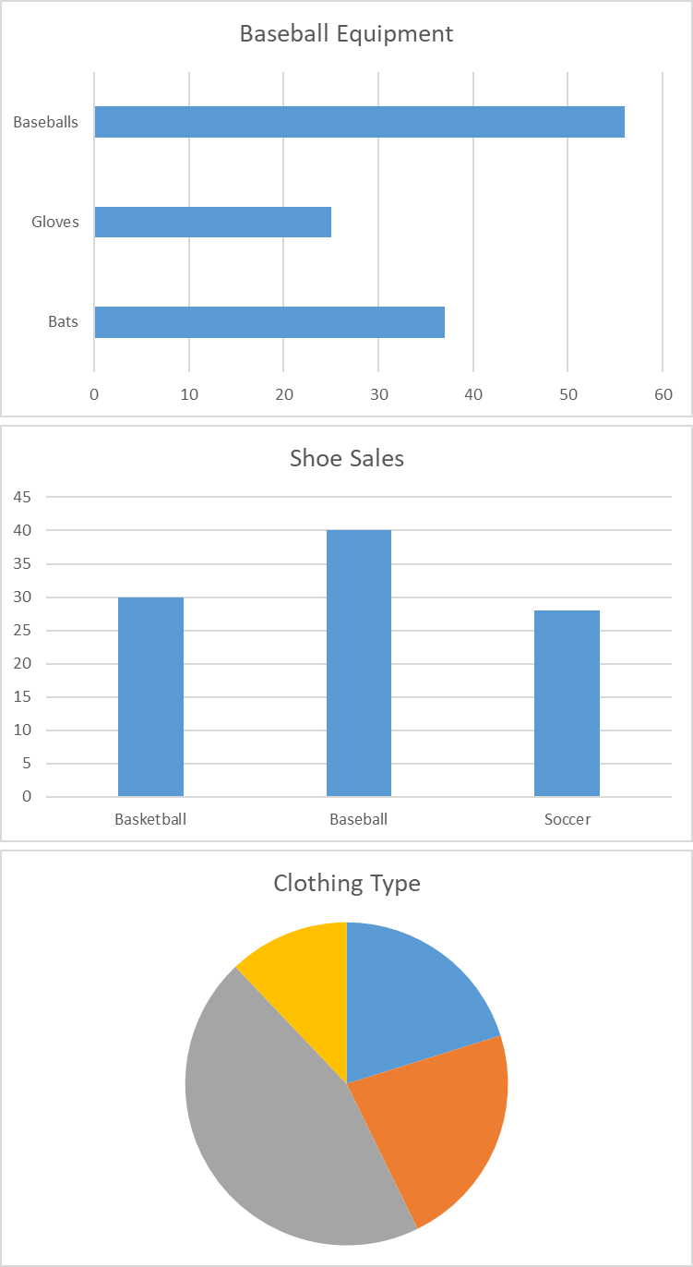
Do: Use consistent chart types
Human’s have to “recalibrate” each time they see a new chart type. The group on the left is much easier to read because no recalibration is needed when moving from chart to chart.
Better: Use consistent chart type
Worse: Vary chart types

Slide 35
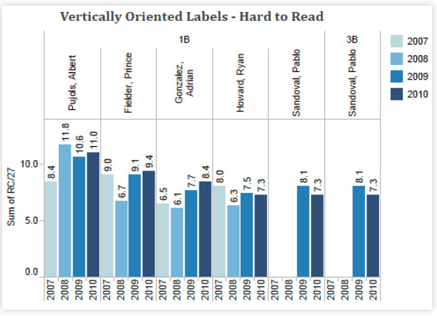
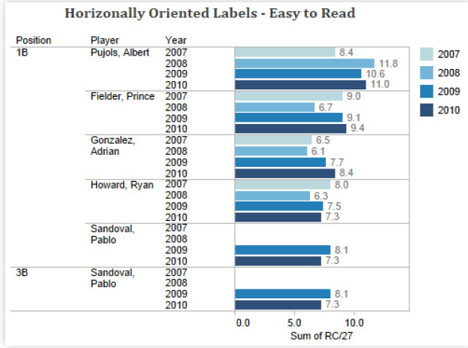
Best Practices Angle text so it is easier to read

Slide 36
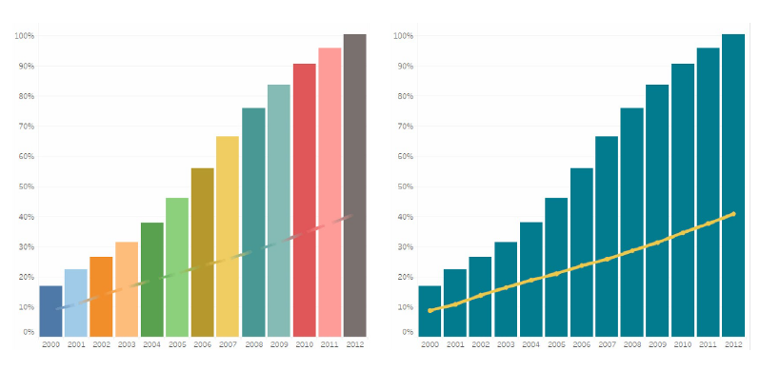
Best Practices Limit the number of colors used on a chart
Maximize info to ink ratio

Slide 37
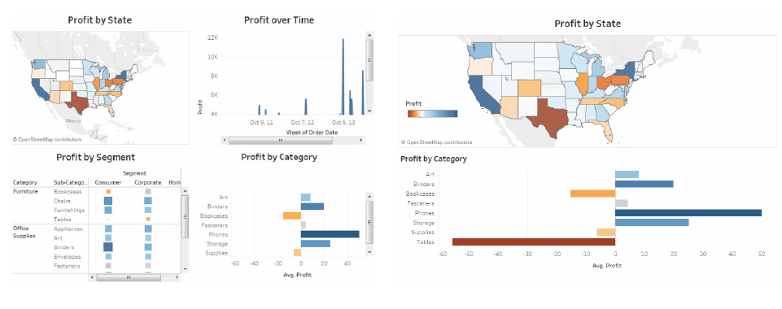
Best Practices Avoid clutter
Right vs. left dashboard

Slide 38
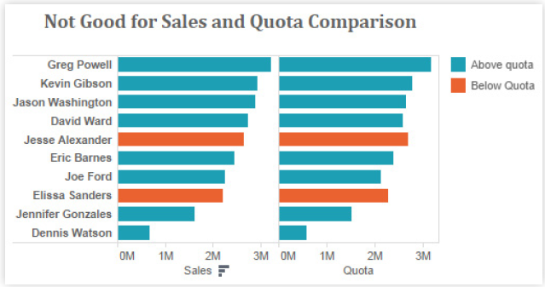
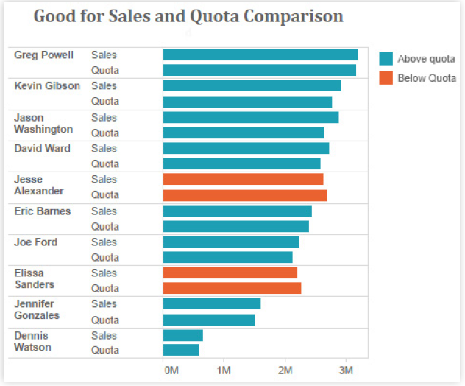
Best Practices Arrange data to make analysis easy

Slide 39
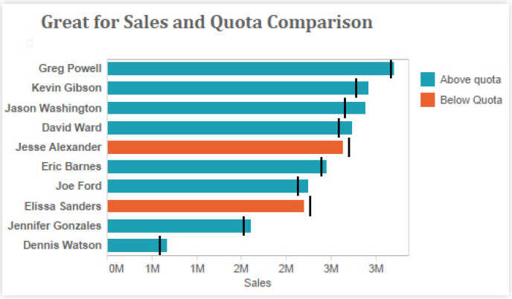
Best Practices Arrange data to make analysis easy

Slide 40
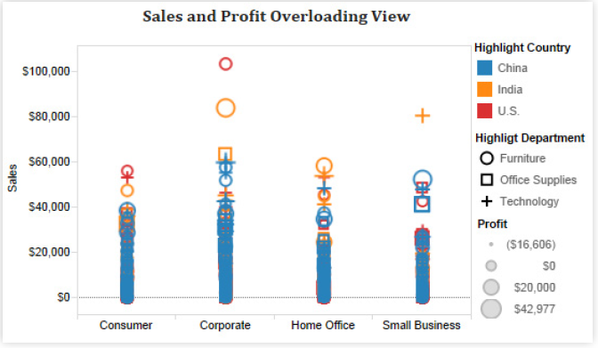
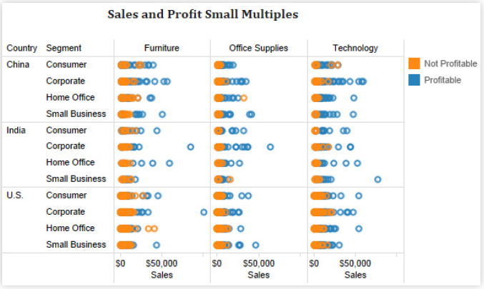
Best Practices Small Multiples
Use Small Multiples if there are too many categories which can be displayed in a single chart

Slide 41
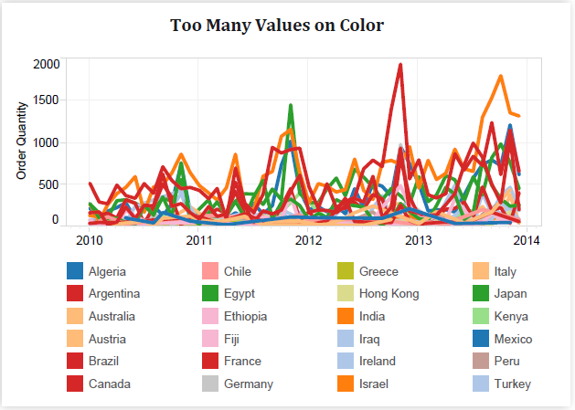
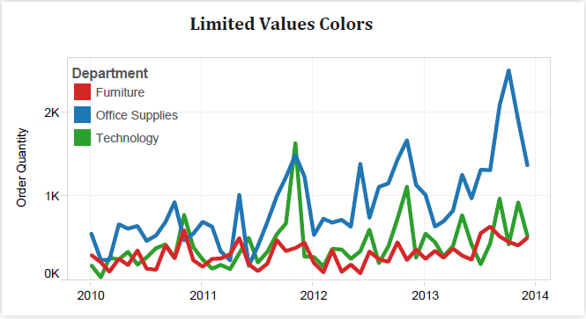
Best Practices Limit number of Colors

Slide 42
Best Practices Other considerations
Use easily legible font types
Try not to use too many colors per page
Keep axes and labels in neutral color
Use fixed axis to make comparisons easier
Use proper axis labels and units
Be careful with dual axis charts

Slide 43
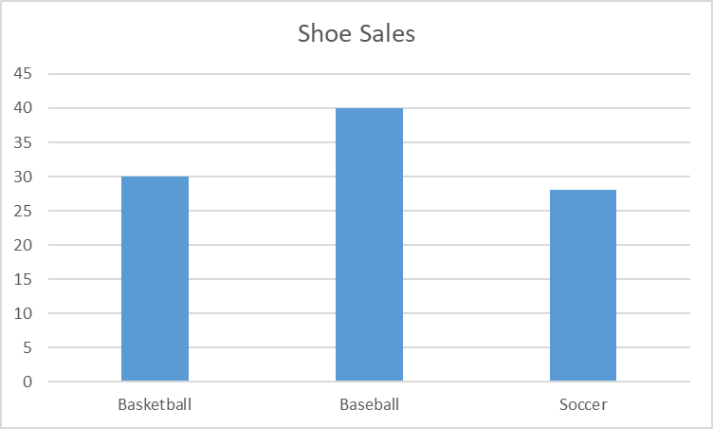
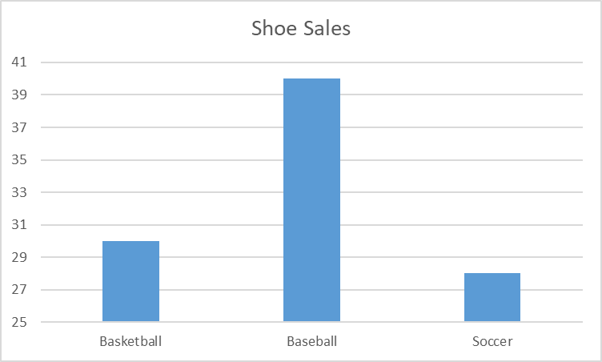
Do: Avoid distortion
For bar charts, be careful to have the vertical (y-axis) start at zero. The charts below show the same data but send very different messages.
Good: Start y-axis at zero
Unacceptable: Start y-axis at non-zero value

Slide 44
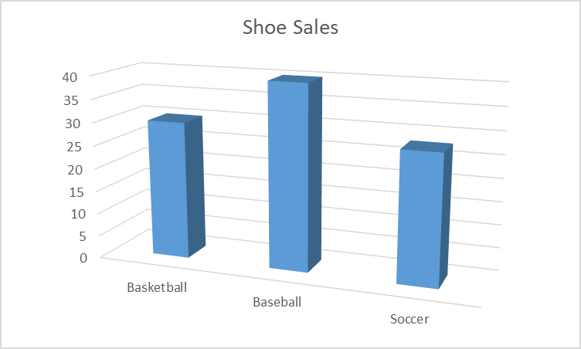
Do: Keep it simple
Most of the time, “fancy” features distract the viewer from the message.
Good: Nice and simple
Bad: 3D effect makes it difficult to read

Slide 45
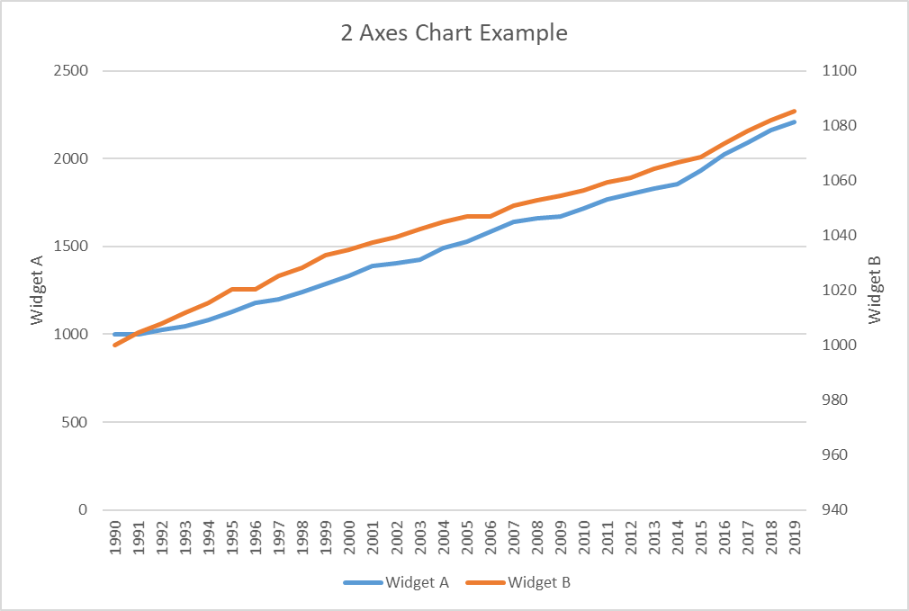
Be careful with charts that have more than one axis

Slide 46
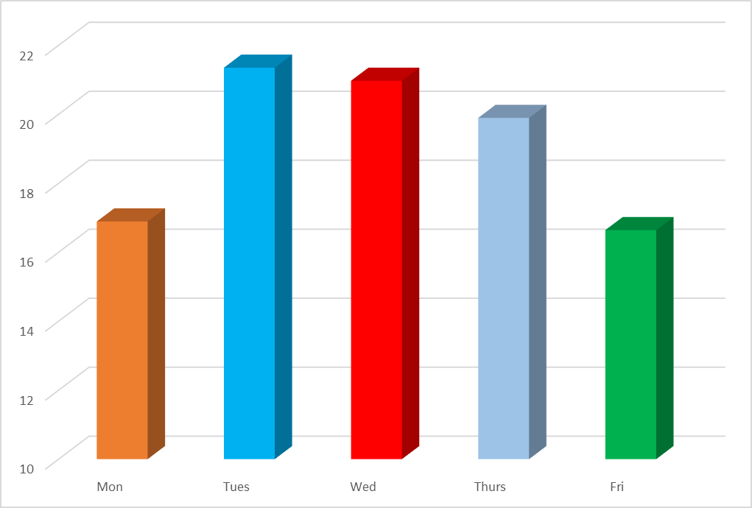
What is wrong with this chart…

Slide 47
Software
Software for creating visualizations comes in many shapes and sizes with varying ease of use and features.
Software | Brief Description
Microsoft Excel (used for some of these slides) | Spreadsheet
Tableau (used for some of these slides) | Dashboard software
Spotfire | Dashboard software
R | Statistical software
Matlab | Matrix math
Python | Programming language

Slide 48
Python plotting libraries
Matplotlib: low level, provides lots of freedom (most popular plotting library)
Pandas Visualization: easy to use interface, built on Matplotlib
Seaborn: high-level interface, great default styles, also build on Matplotlib
ggplot: based on R’s ggplot2, uses Grammar of Graphics
Plotly: can create interactive plots

Slide 49
Useful Websites
https://python-graph-gallery.com/
https://www.shanelynn.ie/python-pandas-read_csv-load-data-from-csv-files/

Slide 50
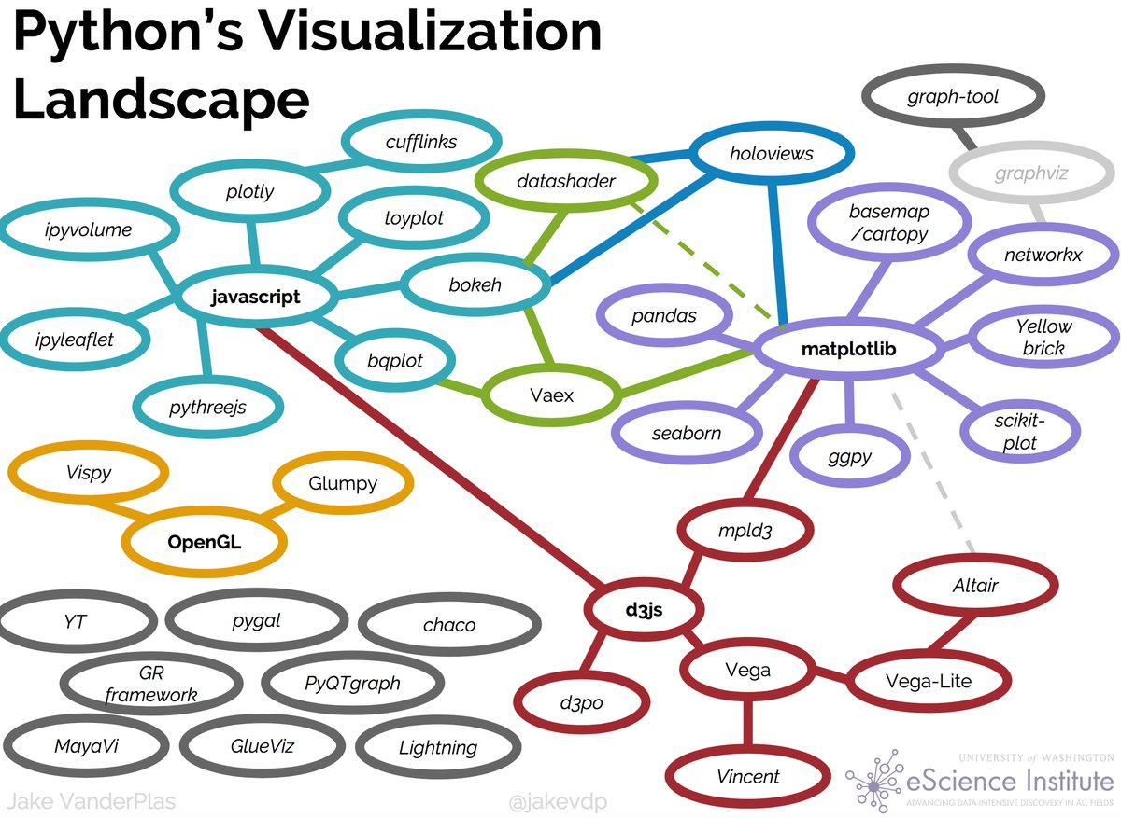
Python plotting libraries

Slide 51
Matplotlib
https://matplotlib.org/tutorials/introductory/sample_plots.html

Slide 52
Python Chart Examples
See Jupyther notebook

Slide 53
References
Tableau.com
whitepaper_visual-analysis-guidebook_0.pd.pdf
building_effective_dashboards.pd.pdf
Anaconda
https://www.anaconda.com/python-data-visualization-2018-why-so-many-libraries/
Daniel Kern
2018 version of this deck
Kirk Goldsberry
https://www.kirkgoldsberry.com/

